Slide 1




Using Best Practice to Develop Individualized Pathways to Employment
Jill Curry, Lincoln-Sudbury Regional High School
Ryan Claire Connors, Newton Public Schools
May 15, 2025 3-4pm
Work in Progress: Employment and Community Life!

Slide 2

Agenda
  Explore best practices
  Consider the roles of various stakeholders
  Discuss success stories
  Review resources
  Q&A
2

Slide 3


Importance of Work Experiences
  Contributes to building self-esteem and developing a sense of independence
  Provides students with opportunities to demonstrate responsibility
  Helps students become contributing members of their communities
  Helps raise awareness of different types of skills and abilities
  Helps students achieve goals financially and socially
  Is a typical expectation of youth/adults
3

Slide 4


Planning for the World of Work
  Best practice approach for employment planning
    Person-centered planning & assessment to develop personalized worker profile
    Job development & placement as needed
    Onsite job training based on specific needs
    Ongoing support based on specific needs
  Consider using YouTube or other virtual job shadow websites and video vignettes of different careers to explore careers
4
Notes:
Consider student's lifestyle and skills and employer’s task needs
A good job match also considers the work environment and the work culture
Starts with student’s interests, not job slots
Many options to help support interest exploration and goal setting
Interests/skills create blueprint for planning

Slide 5

Preparing for the World of Work
  Engage in work focused classes & activities
  Identify soft skill & hard skill development opportunities
  Access Pre-ETS
  Collaborate with community organizations and partners
  Explore a range of options
    Internships
    Job Shadows
    Volunteer Experiences
    Informational Interviews
    Supported Employment
    Independent Paid Employment
5

Slide 6

Role of the Student
  Be an active participant throughout the career exploration and work process
    Classes, work experiences, IEP process
  Keep an open mind when exploring a variety of work experiences and settings
  Build an understanding of matching interests and strengths with current skill sets and task requirements
  Identify how strengths and challenges align with a desired work environment
  Communicate and collaborate with the entire team
  Demonstrate independence across settings
  Use a flexible mindset when considering work place requirements
    Uniforms, phone & earbud usage, shift lengths, timing of shifts, transportation
6

Slide 7

Role of Schools and Educators
  Support the student in understanding their learning style & disability
  Discuss the student’s vision and interests & participation in the IEP process
  Assist individuals to understand the range of work options
  Provide career preparation, develop a resume, & support the completion of applications
  Identify job fairs & community opportunities
  Develop job shadow experiences as needed
  Coordinate informational interviews, volunteer and/or work experiences as needed
  Submit referrals as appropriate and collaborate with adult agencies, families, & employers
  Work with the entire/multidisciplinary team to set appropriate expectations and roles for all involved in work experience
7

Slide 8

Role of the Family
  Frequently discuss careers and work experiences
  Assist student with identifying interests/vision
  Support student participation in IEP meetings
  Maintain expectation of work, including paid or unpaid chores & volunteering
  Support the development of self-determination skills
  Take public transportation, ride shares, or walk together
  Reinforce positive work behaviors (e.g. hygiene, being on time, “working” with others)
  Encourage independence
  Use networks to identify job opportunities!
  Gather required paperwork to complete the hiring process (I-9 documents)
  Discuss strengths and challenges openly
8

Slide 9

Factors to Consider when Exploring Employment
  The role of the employer
  Minimal/No pre-employment exposure
  Fear of unknown
  Resistance to a wide range of opportunities or tasks
  Mismatch of desired tasks and current skill level
  Finding a match between the work environment & the young adult
  Transportation
  Scheduling & availability
  Environmental factors
  Types of tasks
9

Slide 10

Success Stories #1
Student name: Diya
Team members: Special Education Teacher, Employment & Community Resource Specialist, Social Worker, Sr. Career Counselor (MassAbility)
Type of experience: Paid employment acquired through job fair
Work location: Grocery store
Potential Barriers: Transportation, timing of shifts (evening/night), nuances of the workplace, interpersonal skills
Supports: Assistance with communication, problem solving, travel training & scheduling
Tasks: Collecting carts, maintaining recycling machines & a year in cross trained in produce
Planning Considerations: Time to travel train student to ensure they had several means of transport as options to get to/from work, location
Outcomes: Continued paid employment, eventually pursued a different position in a retail store
10

Slide 11
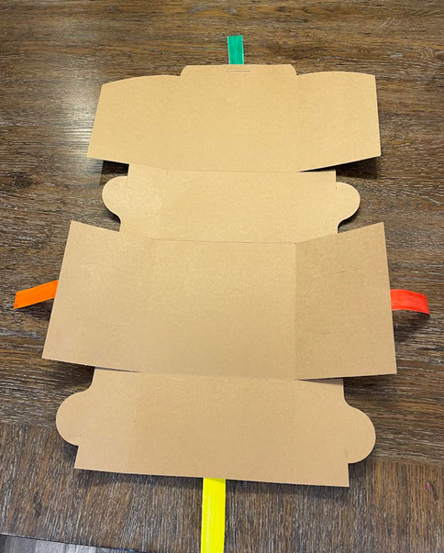
Success Stories #2
Student name: Josie
Team members: Special Education Teacher, Family, Occupational Therapist, Teacher of Students with Visual Impairments, Orientation and Mobility Specialist, Employment & Community Resource Specialist, Social Worker
Type of experience: Internship with job coach support
Work location: Bakery
Potential Barriers: Youth readiness for work, resistance from team members based on the fear of the unknown
Supports: 1:1 job coach, visual aides, weekly pre-work check in’s
Tasks: Folding pastry boxes
Planning Considerations: Familiar environment
Outcomes: Youth decided to not continue opportunity
11

Slide 12
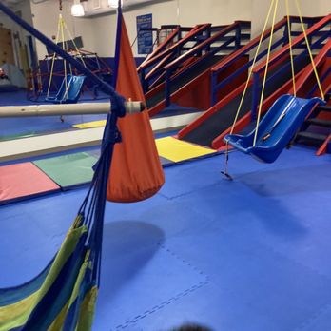
Success Stories #3
Student name: Gabriel
Team members: Special Education Teacher, Social Worker, Family, Employment & Community Resource Specialist
Type of experience: Paid employment
Work location: Gym
Potential Barriers: Health/medical concerns, transportation
Supports: Assistance with application, interview, job coaching with faded support plan, collaboration with work site supervision
Tasks: Organizing toys, managing rules/expectations for clients
Planning Considerations: Environmental factors
Outcomes: Started with 4 hours per week, adding additional hours as needed, grew to 5 hour shifts, at age 22 was working 20+ hours a week
12

Slide 13
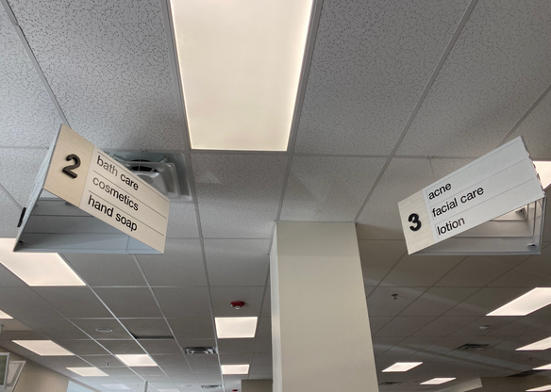
Success Stories #4
Student name: Jordan
Team members: Special Education Teacher, Family, Employment & Community Resource Specialist, Career Counselor (JVS), Sr. Career Counselor (MassAbility)
Type of experience: Paid employment
Work location: Pharmacy/retail
Potential Barriers: Summer plans, available hours on business’ side to ensure meaningful experience, post 22 plan, nuances of the workplace, interpersonal skills
Supports: Limited job coaching, aisle breakdown, checklist in phone, assistance with application, supported interview, collaboration with supervisor
Tasks: Facing, vacuuming, dusting, product returns
Planning Considerations: Shift start time, customer traffic, length of shift, transportation
Outcomes: Continued paid employment twice per week for a total of 4 hours
13

Slide 14
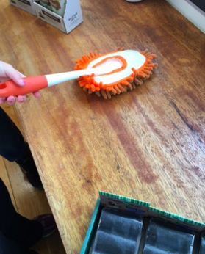
Success Stories #5
Student name: Gail
Team members: Special Education Teacher, Employment & Community Resource Specialist, Teaching Assistant/Job Coach, family
Type of experience: Internship that evolved into paid employment
Work location: Pet groomer
Potential Barriers: Not being able to interact with the dogs, stamina
Supports: 1:1 job coach, visual check list, recording of tasks to use in classroom as a learning tool
Tasks: Dusting & washing front door glass
Planning Considerations: Shift start time, setting that was of interest to the worker, ability to have consistent 1:1 job coaching, structured work environment with as few unknowns as possible
Outcomes: Family and DDS utilized pet groomer experience to develop an additional paid work site at a nail salon
14

Slide 15

Success Stories #6
Student name: Matteo
Team members: Facilitator, Employment & Community Resource Specialist, family
Type of experience: Internship that evolved into paid employment
Work location: Lawyer’s office
Potential Barriers: location/transportation, interpersonal skills, nuances of the workplace
Supports: 1:1 job coach with faded support plan, interview preparation, supported interview, school had frequent check in’s with supervisor
Tasks: Organized files by filing, scanned documents and labeled them in data base
Planning Considerations: Work environment, task aligned with student interest and worker profile
Outcomes: Continued with paid employment until youth made a change
15

Slide 16

Lessons Learned
  Ensure the youth’s vision is the focus of planning
  Consider the career development trajectory!
    Where a young adult begins their employment journey may not be where they end up
  Work environments are critical to consider!
  Family role and changes at various life transitions (turning 22, aging family members, etc) may impact work
  Be realistic with what can be controlled at work sites and what can’t
  Challenges & unexpected moments will happen!
16
Notes:
(Move to notes:Young adults may realize where they think they want to work, may not end up being the best fit)
Ensure the youth's vision is the focu, not what other team members would like

Slide 17

Tips & Strategies to Create Pathways to Employment
  All team members should consider using their personal and professional networks
  Work with employers to explore potential alternatives to traditional interview process
  Keep an open mind!
  Consider the career development trajectory...use each experience to gain skills
  Explore a range of job supports as needed, including natural supports, visual aides, & job coaching
    Not all students will require onsite job support
  Consider creating partnerships with local businesses to match workers
17
Notes:
(Move to notes:Young adults may realize where they think they want to work, may not end up being the best fit)

Slide 18

Resources
  Handouts
    Two redacted fading plans
    5 Bold Steps template for Person-Centered Planning
    List of Key Terms
  ONET: https://www.onetonline.org/
  My Next Move: https://www.mynextmove.org/
  MassHire360: https://portal.ma.cis360.org/
18
Notes:
(Move to notes:Young adults may realize where they think they want to work, may not end up being the best fit)

Slide 19


Contact Information
Jill Curry
LS Career Counselor
jill_curry@lsrhs.net, 978-443-9961 x3333
Ryan Claire Connors
NPS Employment & Community Resource Specialist
617-559-6164, connorsr@newton.k12.ma.us
19
Notes:
(Move to notes:Young adults may realize where they think they want to work, may not end up being the best fit)

